Slide 1
Lecture-2 Recap Lecture-1
Introduction to the course title, Formal and In-formal languages, Alphabets, Strings, Null string, Words, Valid and In-valid alphabets, length of a string, Reverse of a string, Defining languages, Descriptive definition of languages, EQUAL, EVEN-EVEN, INTEGER, EVEN, { a^{n} b^{n}}, { a^{n} b^{n} a^{n} }, factorial, FACTORIAL, DOUBLEFACTORIAL, SQUARE, DOUBLESQUARE, PRIME, PALINDROME.

Slide 2
Task
Q) Prove that there are as many palindromes of length 2n, defined over Σ = {a,b,c}, as there are of length 2n-1, n = 1,2,3… . Determine the number of palindromes of length 2n defined over the same alphabet as well.

Slide 3
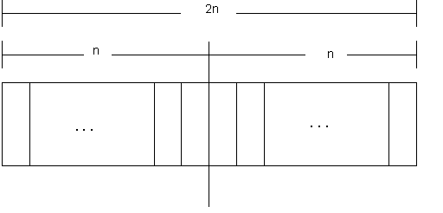
Solution
To calculate the number of palindromes of length(2n), consider the following diagram,

Slide 4
which shows that there are as many palindromes of length 2n as there are the strings of length n i.e. the required number of palindromes are 3^{n} (as there are three letters in the given alphabet, so the number of strings of length n will be 3^{n} ).

Slide 5
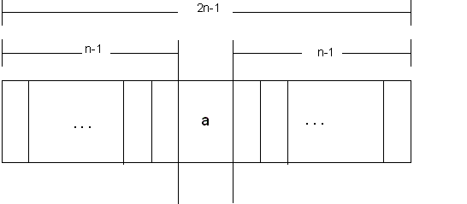
To calculate the number of palindromes of length (2n-1) with a as the middle letter, consider the following diagram,

Slide 6
which shows that there are as many palindromes of length 2n-1, with a as middle letter, as there are the strings of length n-1, i.e. the required number of palindromes are 3^{n-1}.
Similarly the number of palindromes of length 2n-1, with b or c as middle letter, will be 3^{n-1} as well. Hence the total number of palindromes of length 2n-1 will be 3^{n-1} + 3^{n-1} + 3^{n-1} = 3 (3^{n-1})= 3^{n} .

Slide 7
Kleene Star Closure
Given Σ, then the Kleene Star Closure of the alphabet Σ, denoted by Σ*, is the collection of all strings defined over Σ, including Λ.
It is to be noted that Kleene Star Closure can be defined over any set of strings.

Slide 8
Examples
If Σ = {x}
Then Σ* = {Λ, x, xx, xxx, xxxx, ….}
If Σ = {0,1}
Then Σ* = {Λ, 0, 1, 00, 01, 10, 11, ….}
If Σ = {aaB, c} d
Then Σ* = {Λ, aaB, c, aaBaaB, aaBc, caaB, cc, ….}

Slide 9
Note
Languages generated by Kleene Star Closure of set of strings, are infinite languages. (By infinite language, it is supposed that the language contains infinite many words, each of finite length).

Slide 10
Task
Q)
1) Let S={ab, bb} and T={ab, bb, bbbb} Show that S* = T* [Hint S*  T* and T*  S*]
2) Let S={ab, bb} and T={ab, bb, bbb} Show that S* ≠ T* But S* ⊂ T*
3) Let S={a, bb, bab, abaab} be a set of strings. Are abbabaabab and baabbbabbaabb in S*? Does any word in S* have odd number of b’s?

Slide 11
PLUS Operation (⁺)
Plus Operation is same as Kleene Star Closure except that it does not generate Λ (null string), automatically.
Example:
If Σ = {0,1}
Then Σ⁺ = {0, 1, 00, 01, 10, 11, ….}
If Σ = {aab, c}
Then Σ⁺ = {aab, c, aabaab, aabc, caab, cc, ….}

Slide 12
TASK
Q1)Is there any case when S⁺ contains Λ? If yes then justify your answer.
Q2) Prove that for any set of strings S
(S⁺)*=(S*)*
(S⁺)⁺=S⁺
Is (S*)⁺=(S⁺)*

Slide 13
Remark
It is to be noted that Kleene Star can also be operated on any string i.e. a* can be considered to be all possible strings defined over {a}, which shows that a* generates
Λ, a, aa, aaa, …
It may also be noted that a⁺ can be considered to be all possible non empty strings defined over {a}, which shows that a⁺ generates
a, aa, aaa, aaaa, …

Slide 14
Defining Languages Continued…
Recursive definition of languages
The following three steps are used in recursive definition
Some basic words are specified in the language.
Rules for constructing more words are defined in the language.
No strings except those constructed in above, are allowed to be in the language.

Slide 15
Example
Defining language of INTEGER
Step 1:
1 is in INTEGER.
Step 2:
If x is in INTEGER then x+1 and x-1 are also in INTEGER.
Step 3:
No strings except those constructed in above, are allowed to be in INTEGER.

Slide 16
Example
Defining language of EVEN
Step 1:
2 is in EVEN.
Step 2:
If x is in EVEN then x+2 and x-2 are also in EVEN.
Step 3:
No strings except those constructed in above, are allowed to be in EVEN.

Slide 17
Example
Defining the language factorial
Step 1:
As 0!=1, so 1 is in factorial.
Step 2:
n!=n*(n-1)! is in factorial.
Step 3:
No strings except those constructed in above, are allowed to be in factorial.

Slide 18
Defining the language PALINDROME, defined over Σ = {a,b}
Step 1:
a and b are in PALINDROME
Step 2:
if x is palindrome, then s(x)Rev(s) and xx will also be palindrome, where s belongs to Σ*
Step 3:
No strings except those constructed in above, are allowed to be in palindrome

Slide 19
Defining the language {a^{n}b^{n} }, n=1,2,3,… , of strings defined over Σ={a,b}
Step 1:
ab is in {a^{n}b^{n}}
Step 2:
if x is in {a^{n}b^{n}}, then axb is in {a^{n}b^{n}}
Step 3:
No strings except those constructed in above, are allowed to be in {a^{n}b^{n}}

Slide 20
Defining the language L, of strings ending in a , defined over Σ={a,b}
Step 1:
a is in L
Step 2:
if x is in L then s(x) is also in L, where s belongs to Σ*
Step 3:
No strings except those constructed in above, are allowed to be in L

Slide 21
Defining the language L, of strings beginning and ending in same letters , defined over Σ={a, b}
Step 1:
a and b are in L
Step 2:
(a)s(a) and (b)s(b) are also in L, where s belongs to Σ*
Step 3:
No strings except those constructed in above, are allowed to be in L

Slide 22
Defining the language L, of strings containing aa or bb , defined over Σ={a, b}
Step 1:
aa and bb are in L
Step 2:
s(aa)s and s(bb)s are also in L, where s belongs to Σ*
Step 3:
No strings except those constructed in above, are allowed to be in L

Slide 23
Defining the language L, of strings containing exactly aa, defined over Σ={a, b}
Step 1:
aa is in L
Step 2:
s(aa)s is also in L, where s belongs to b*
Step 3:
No strings except those constructed in above, are allowed to be in L

Slide 24
Summing Up
Kleene Star Closure, Plus operation, recursive definition of languages, INTEGER, EVEN, factorial, PALINDROME, {a^{n}b^{n}}, languages of strings (i) ending in a, (ii) beginning and ending in same letters, (iii) containing aa or bb (iv)containing exactly aa,

